Slide 1


Student Name, Batch, Roll No
Deep Jadhav (G3 batch) -7050
Rudraprasad vishwamitre(G3 batch)-7049
Dhaval Bora(G3 batch)-7062
Akshay Misal (G3 batch)-7064

Slide 2
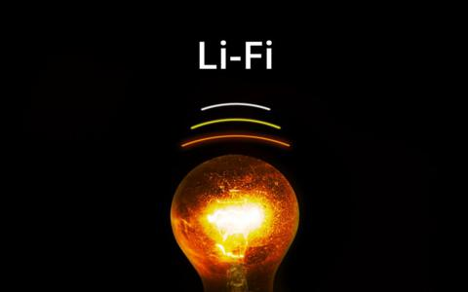
INTRODUCTION OF LIFI
The Li-Fi (light fidelity) technology was proposed by the German Scientist namely Harald Haas.
The main function of this technology is to transmit the data via light. This technology is idyllic for high-speed wireless communication in a restricted region, and it offers many benefits over Wi-Fi technology such as high bandwidth, ease of use, efficiency, and safety.
These systems can communicate from street lights to auto-piloted cars using their headlights. As the light speed is superior hence the data communication speed is also faster in the existing system.
Furthermore, this technology can be implemented for speedy data access for the laptops, and gadgets that will be transmitted during the beam in a room.
Li-Fi Technology

Slide 3

INTRODUCTION OF LIFI
Li-Fi-light fidelity is similar to Wi-Fi technology and it is one of the future wireless communication technologies.
The main feature of this technology includes fully networked, bidirectional and high-speed wireless.
Nowadays, the most trending domain in wireless communication is Wi-Fi and internet users are also being increased every year.
The data transmission in this technology can be done using light because the light intensity changes quicker than the human eye for capturing.
The range of data transmission in L-Fi is faster 100 times than Wi-Fi.

Slide 4
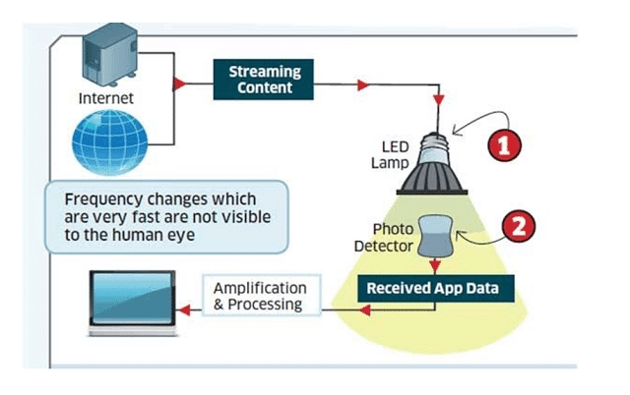
WORKING OF LI-FI
LiFi is high speed bidirectional networked and mobile communication of data using light. LiFi comprises of multiple light bulbs that form a wireless network.
When an electrical current is applied to a LED light bulb a stream of light (photons) is emitted from the bulb.
LED bulbs are semiconductor devices, which means that the brightness of the light flowing through them can be changed at extremely high speeds.
This allows us to send a signal by modulating the light at different rates. The signal can then be received by a detector which interprets the changes in light intensity (the signal) as data.
The intensity modulation cannot be seen by the human eye, and thus communication is just as seamless as other radio systems, allowing the users to be connected where there is LiFi enabled light. Using this technique, data can be transmitted from a LED light bulb at high speeds

Slide 5
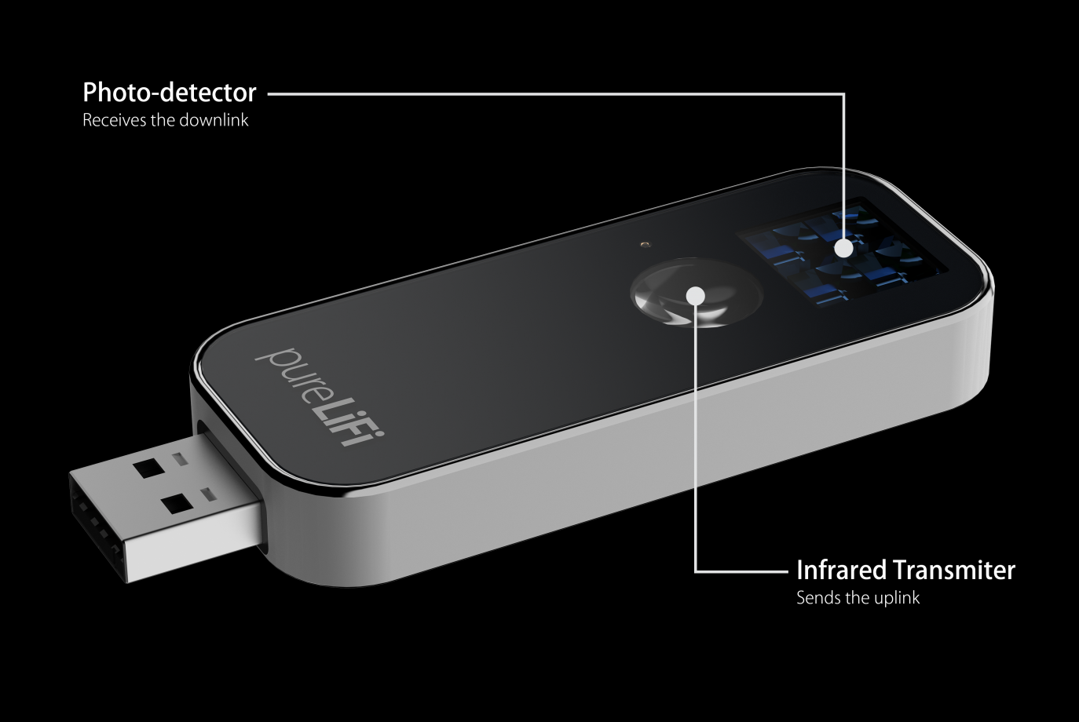
WORKING
This brilliant idea was first showcased by Harald Haas from University of Edinburgh, UK, in his TED Global talk on VLC. He explained,” Very simple, if the LED is on, you transmit a digital 1, if it’s off you transmit a 0.
The LEDs can be switched on and off very quickly, which gives nice opportunities for transmitting data.” So what you require at all are some LEDs and a controller that code data into those LEDs.
Further enhancements can be made in this method, like using an array of LEDs for parallel data transmission, or using mixtures of red, green and blue LEDs to alter the light’s frequency with each frequency encoding a different data channel.
LED can be switched on and off to generate digital strings of 1s and 0s. Data can be encoded in the light to generate a new data stream by varying the flickering rate of the LED. To be clearer, by modulating the LED light with the data signal
the LED illumination can be used as a communication source. As the flickering rate is so fast, the LED output appears constant to the human eye. A data rate of greater than 100 Mbps is possible by using high speed LEDs with appropriate multiplexing techniques.

Slide 6
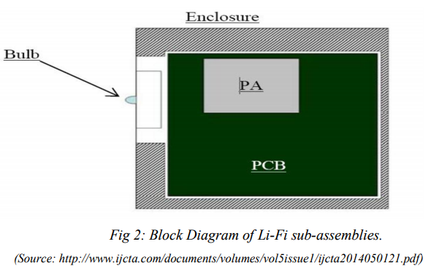
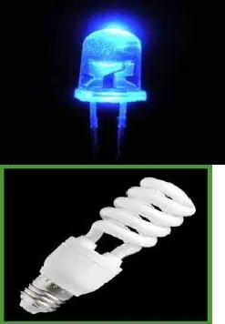
LI-FI CONSTRUCTION
The LI-FI™ product consists of 4 primary sub-assemblies:
• Bulb
• RF power amplifier circuit (PA)
• Printed circuit board (PCB)
• Enclosure
Transmitters:
The following components are used at the transmitting side:
Colored LEDs
Mosfets
RS232 line driver IC
USB to RS232 coverter cable
Voltage Regulator
Receivers:
The following components are used at the receiving side:
Optical Receiver
Optical Filters
Voltage Regulator
RS232 line driver IC
USB to RS232 converter cable
Solid state LED and fluorescent bulb used as transmitter

Slide 7
COMPARISION OF LIFI WITH OTHER TECHNOLOGIES
CHARACTERISTICS | BLUETOOTH | WI-FI | LI-FI
Frequency | 24GHz | 24 GHz-50GHz | No frequency for light
Range | 10 meters | 100 meters | Based on LED light falling
Primary application | WPAN | WLAN | Where ever light is available
Data Transfer rate | 1OOKb ps | 11Mbps | >1 Gbps
Power Consumption | Low | Medium | Medium
Cost | Low | Medium | Low
Security | Less secure | Medium secure | High secure
Primary Devices | Traveling employees electronics Consumers office and industrial workers | Notebook computers, Mobile phones, FDAsdesktop | Mobile phones, PDAS,consumerelectronics, office antidetonation devices Notebook computers, desktop computers, servers, latest mobiles, iPods etc. and other latest devices with Li-fi
Primary Users | Traveling employees electronics consumers office and industrial workers | Corporate campus users and homes, flats, public places | Traveling employees Corporate campus users and homes, flats public places and industrial and power plants, hospitals.
Usage Location | Anywhere at least two Bluetooth devices exist | Building Within range of WLANinfrastructure, usually inside 2building | Anywhere where lights available like roads, public place, home, office, etc.
Standard | IEEE 802 15 | IEEE 802 11b | SEE 802.15
Operating Band | 15M Band | RF Band | Visible light band
Maximum Members | 7 members connect at time | Number of devices connected is dependent upon size of bandwidth | Number of receiver present under light
Development Started | 1998 | 1990 | 2011
Working Concept | Master-slave | Various Topolo | Direct binary data serving

Slide 8
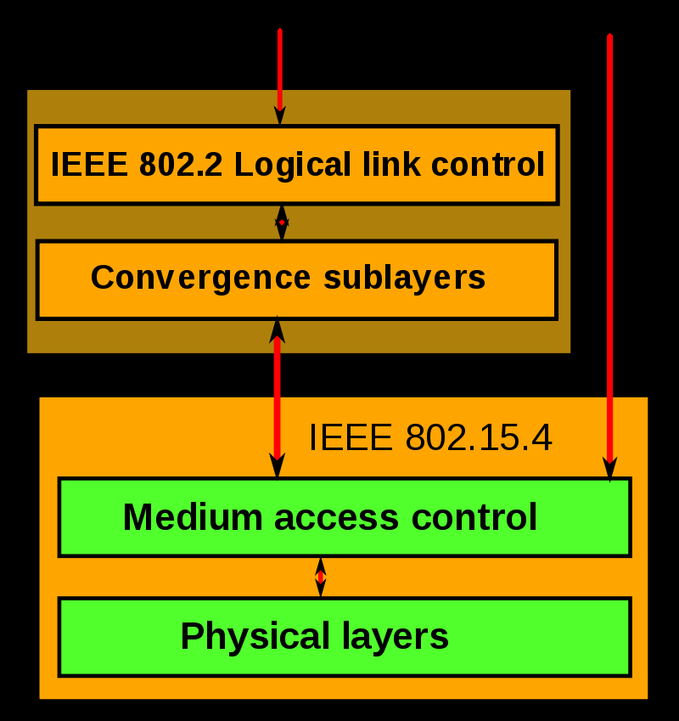
STANDARD FOR BLUETOOTH (IEEE 802.15.4)
IEEE 802.15.4 is a technical standard which defines the operation of low-rate wireless personal area networks (LR-WPANs). It conformant devices may use one of three possible frequency bands for operation (868/915/2450 MHz).
the definition of the network layers is based on the OSI model; although only the lower layers are defined in the standard, interaction with upper layers is intended, possibly using an IEEE 802.2 logical link control sublayer accessing the MAC through a convergence sublayer.
The physical layer: The physical layer is the bottom layer in the OSI reference model used worldwide, and protocols layers transmit packets using it The physical layer (PHY) provides the data transmission service. It also, provides an interface to the physical layer management entity, which offers access to every physical layer management function and maintains a database of information on related personal area networks.
6. The MAC layer
The medium access control (MAC) enables the transmission of MAC frames through the use of the physical channel. Besides the data service, it offers a management interface and itself manages access to the physical channel and network beaconing.
7. Higher layers
No higher-level layers and interoperability sublayers are defined in the standard.
8. The 15-meter band (also called the 21-MHz band or 15 meters) is an amateur radio frequency band spanning the shortwave spectrum from 21 to 21.45 MHz.

Slide 9
Standard For WIFI (IEEE 802.11b)
IEEE 802.11 wireless networking specification that extends throughput up to 11 Mbit/s using the same 2.4 GHz band they are commonly used today in their 802.11a, 802.11b, 802.11g, 802.11n, 802.11ac and 802.11ax versions to provide wireless connectivity in the home, office and some commercial establishments.
802.11b products appeared on the market in mid-1999, since 802.11b is a direct extension of the DSSS (Direct-sequence spread spectrum) modulation technique defined in the original standard.
802.11b devices suffer interference from other products operating in the 2.4 GHz band. Devices operating in the 2.4 GHz range include: microwave ovens, Bluetooth devices, baby monitors and cordless telephones. Interference issues and user density problems within the 2.4 GHz band have become a major concern and frustration for users.
Different versions of Wi-Fi use different techniques, 802.11b uses DSSS on a single carrier, whereas 802.11a, Wi-Fi 4, 5 and 6 use multiple carriers on slightly different frequencies within the channel (OFDM).^{[53][54]}
Wi-Fi Generations
Generation/IEEE Standard | Maximum Link rate | Adopted | Frequency
Wi‑Fi 6E (802.11ax) | 600 to 9608 Mbit/s | 2019 | 6 GHz
Wi‑Fi 6 (802.11ax) | 600 to 9608 Mbit/s | 2019 | 2.4/5 GHz
Wi‑Fi 5 (802.11ac) | 433 to 6933 Mbit/s | 2014 | 5 GHz
Wi‑Fi 4 (802.11n) | 72 to 600 Mbit/s | 2008 | 2.4/5 GHz
802.11g | 6 to 54 Mbit/s | 2003 | 2.4 GHz
802.11a | 6 to 54 Mbit/s | 1999 | 5 GHz
802.11b | 1 to 11 Mbit/s | 1999 | 2.4 GHz
802.11 | 1 to 2 Mbit/s | 1997 | 2.4 GHz

Slide 10
Standard used for LIFI(IEEE 802.15.7)
The figure depicts protocol stack used in a typical VPAN device. As shown protocol stack consists of PHY, MAC and upper layers. Physical layer houses light transceiver. PHY switch housed in PHY layer interfaces with optical SAP which connects it to the optical medium. The optical medium composed of one or multiple optical sources or optical detectors (e.g. laser diodes or photodiodes).
MAC layer provides channel access for all types of data and control message transmissions. Upper layer consists of network layer and application layer.
Network layer takes care of providing network configuration, network manipulation, message routing etc.
Application layer takes care of providing intended functionality as needed by the VPAN or LiFi device.
DME (Device Management Entity) is also supported by LiFi or VPAN network architecture. It makes interfacing between dimmer and PHY/MAC a reality.
LiFi PHY:There are three types of physical layer configurations supported in VLC or LiFi System Viz.
The PHY I was established for outdoor application and works from 11.67 kbit/sto 267.6 kbit/s.
The PHY II layer allows to reach data rates from 1.25 Mbit/s to 96 Mbit/s.
The PHY III is used for many emissions sources with a particular modulation method called color shift keying (CSK). PHY III can deliver rates from 12Mbit/s to 96 Mbit/s. The modulations formats recognized for PHY I and PHY II are the coding on-offkeying (OOK) and variable pulse position modulation (VPPM). The Manchester coding used for the PHY I and PHY II layers include the clock inside the transmitted data by representing a logic 0 with an OOK symbol "01" and a logic 1with an OOK symbol "10", all with a DC component. This is an important point because the DC component allows to avoid the light extinction in case of anextended line of logic 0.The Li-Fi Consortium has also been established to work on standardizing VLC communications, but the rapid evolution of the technology minimizes the impact of any standardization effort.
Different rates can be achieved in different configurations. They can be used indoor or outdoor.
LiFi MAC:MAC layer takes care of resource management i.e. allocation of channels, IDs as well as entire network management.
LiFi Modulation Types-OOK, VPPM, CSK: There are different modulation schemes used in different physical layer modes. OOK stands for On Off Keying, VPPM stands for Variable Pulse Position Modulation and CSK stands for Colour Shift Keying.

Slide 11
RF and Wavebands
Wireless networking is an RF (radio frequency) technology. Air is the vehicle through which the data is carried, just as Ethernet uses copper cables. WLAN frequency ranges are in the 2.4GHz and 5GHZ bands.
The most common legacy wireless standards, 802.11b and 802.11g, use the 2.4GHz range. IEEE 802.11a uses 5GHz exclusively. The newer 802.11n operates mostly in 5GHz but can also use the 2.4GHz band. The forthcoming 802.11ac standard operates in 5GHz. Hence Frequency of operation2.4GHz, 4.9GHz and 5GHz mostly
WIFI supports different speeds and coverage ranges as per implemented standard in the devices (STAs, APs).
802.11a supports up to 54 Mbps,
802.11b up to 11 Mbps,
802.11n supports 72 Mbps/150 Mbps as per BW (20MHz/40MHz),
802.11ac wave-1 supports up to 1.3 Gbps (80MHz, 3 streams, 256QAM),
802.11ac wave-2 supports up to 3.5 Gbps (160MHz, 4 streams, 256QAM) etc. The distance coverage of 70 meters (indoor) to 250 meters (outdoor) can be achieved.
About 1-2 Gbps can be achieved using WI Gig/Giga-IR
In WIFI, RF signal passes through the walls and hence there is a need to employ techniques to achieve secure data transfer.
Coverage distanceAbout 32 meters (WLAN 802.11b/11g), vary based on transmit power and antenna type
LiFi Wavelength Bands of operation
LiFi standard compliant device operates from 380 nm to 780 nm wavelength region. This devices operate on one or multiple visible light frequency bands.
The LiFi bands with spectral with and possible code combinations used are mentioned in the table below. It uses light with wavelength ranging from 380 nm to 780 nm for data communication between LEDs and photo detectors
Present IrDA compliant devices In LiFi, light does not pass through the walls and hence will provide a much secure data transfer data transfer rate is about 1 gbps
Frequency of operation10 thousand times frequency spectrum of the radio
Data densityWorks in high dense environmentCoverage distance About 10 meters

Slide 12
Issues Regarding Radio-spectrum
Data Density
Efficiency:
Availability:
Security:
Loading speeds:
Banned in Sensitive Areas:

Slide 13
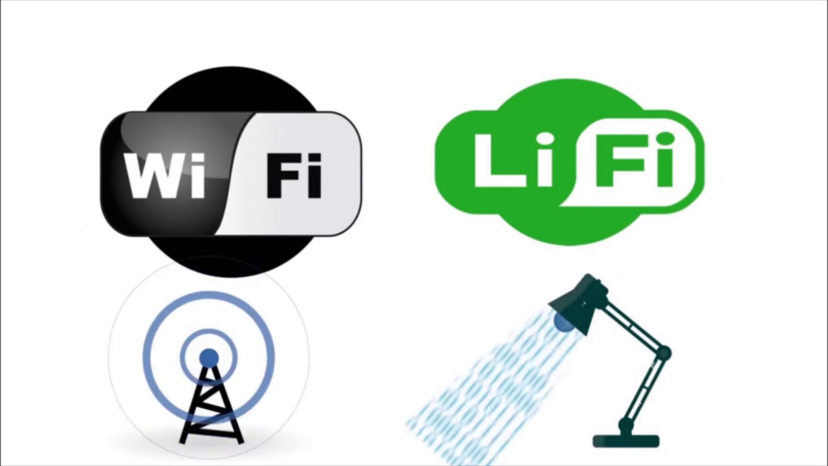
VLC over RF Communication
VLC over RF Communication
Availability of high bandwidth.
Efficiency and security
Unlicensed use, high data density, and data rates
All of this translates to quicker, easier and more secure communication.

Slide 14

Application Of LiFi Technology for Industrial Automation System
We can design the monitoring and control system for the Industrial parameter using the LiFi communication technology
Monitoring is most important in industry.
Monitoring is done by sensor with most accuracy and reliability.
Control process will also be handled by this LIFI communication. Arduino decodes the commands are given through LIFI with the help of LED and control the industrial devices through relays.
The interfacing between LIFI transmitter and LIFI receiver is
done by Arduino. This concept was taken to
reduce human efforts in industry.

Slide 15
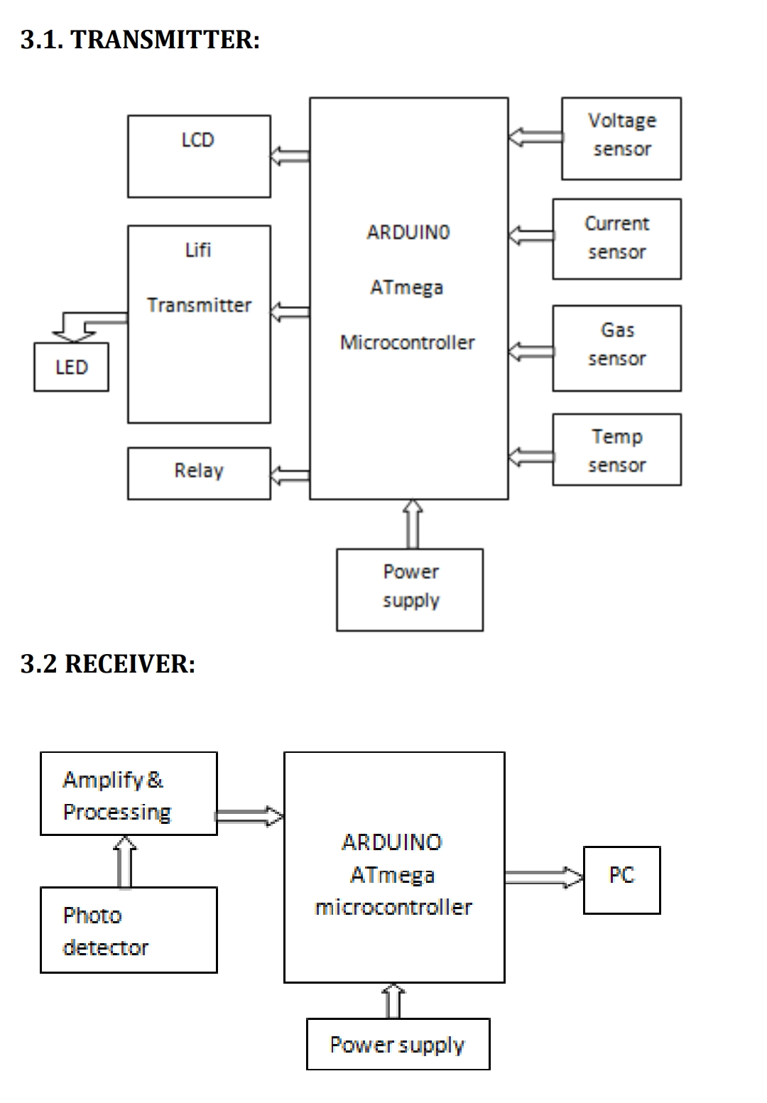
Working
Input such as sensor, current sensor, temperature sensor ,gas sensor are given to ARDUINO development board. LIFI is used to send a message through LED bulb. LIFI provides uninterrupted output. This application is developed for monitor and control the machine health in industry. In existing project WIFI concept is used which is high cost and data transfer speed is 150Mbps .WIFI is difficult to transmit
message to long range. The applicability of LIFI concept is implement in industrial sector itself both monitor and control the machine health. LIFI is cheaper than WIFI because free band does not need license and it uses light.

Slide 16
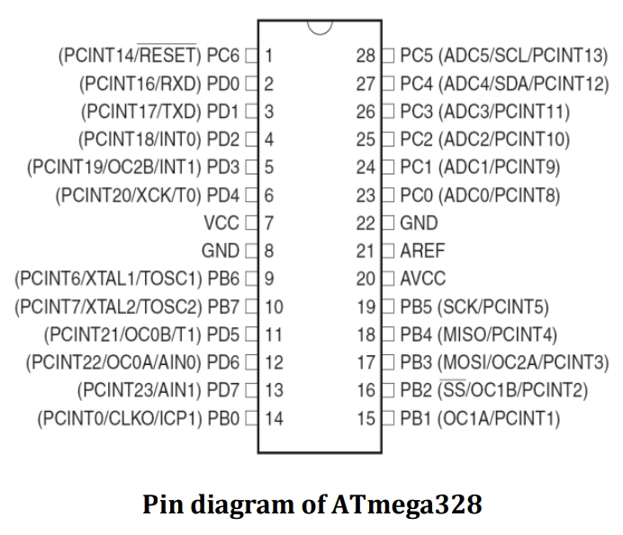
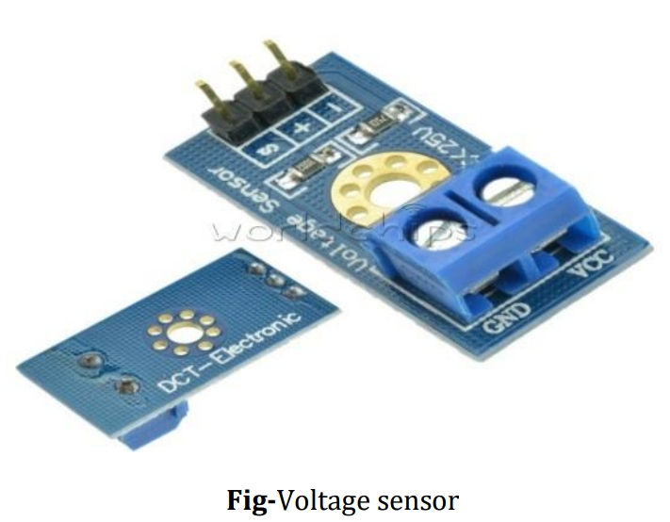
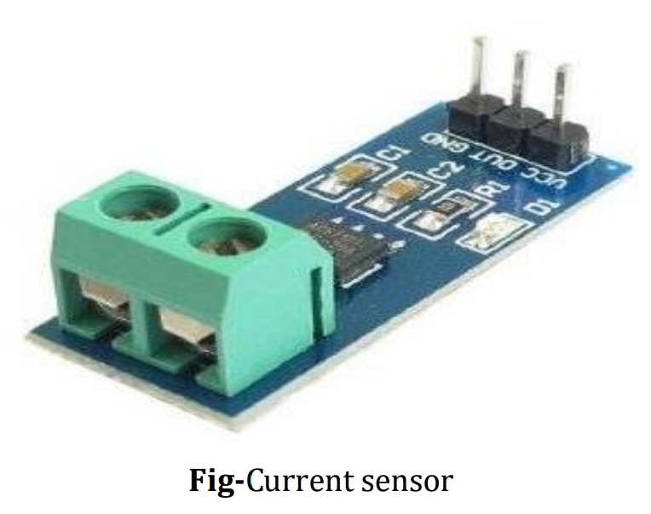
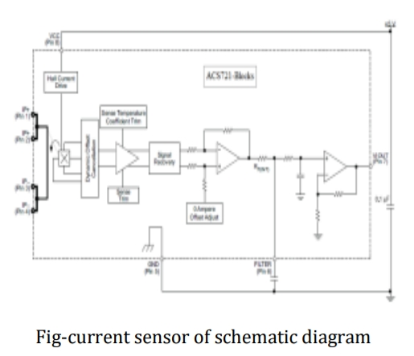
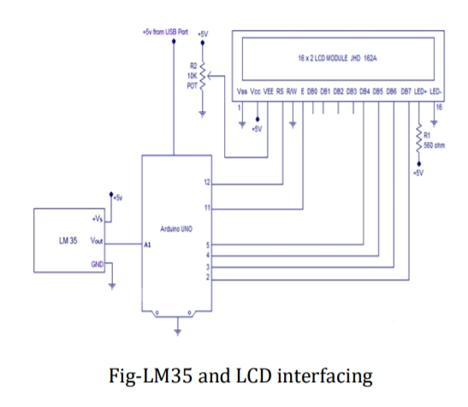
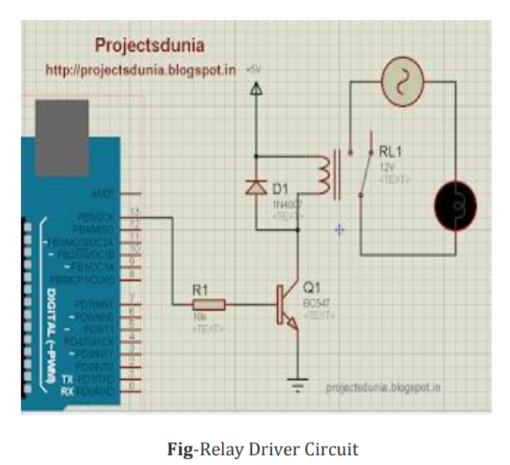
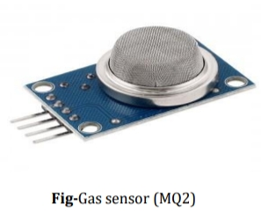
The hardware consists of various components such as
ARDUINO UNO atmega 328
Relay,16*2 LCD
voltage sensor
Current temperaturerature sensor
Gas sensor
LIFI transmitter, photo detector(LIFI receiver),external device (power distributor)DC supply of 5v

Slide 17
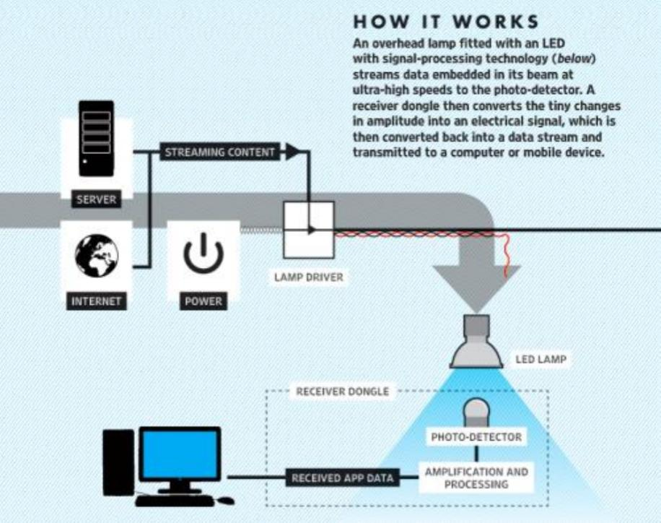
Road Traffic Management and Safety Using Li Fi Technology
Proposed application of VLC includes use of Li Fi technology at traffic signals and at toll plazas. The system uses a toggling LED at transmitting end and a photodiode at receiving end.
LEDs are used to transmit the data at transmitting end. At receiving end a photodiode is connected to PC which senses the transmitted data and feed it to the PC.A PIC microcontroller can be used for toggling of LED at transmitting end.
At receiving end also one has to use a PIC microcontroller connected to output of photodiode. The light received by photodiode is converted to binary data and is fed to the microcontroller.
The microcontroller is connected to the serial port of the PC

Slide 18
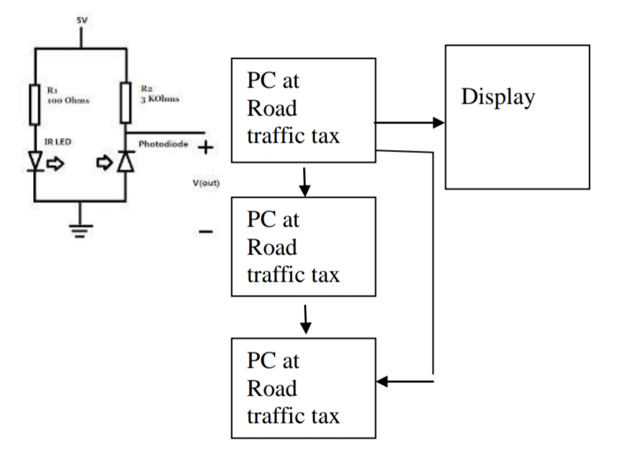
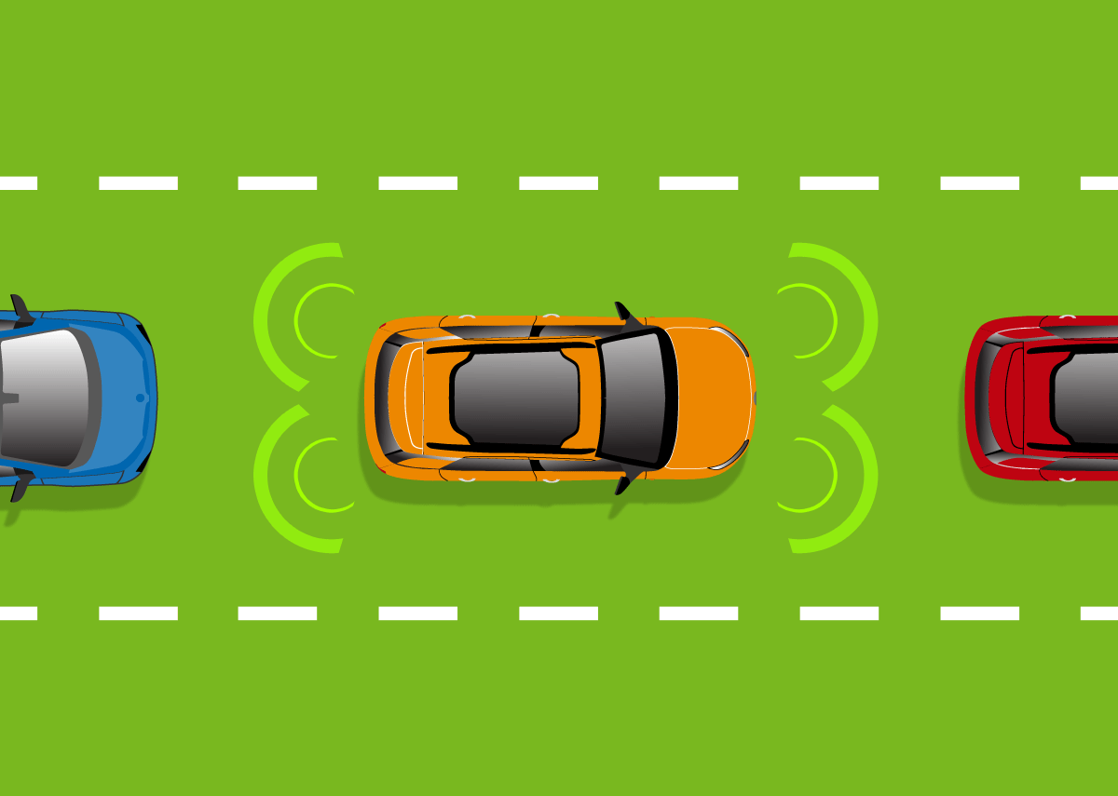
One can make use of head lights and tail
lights of vehicles. As every vehicle has assigned on number, one unique code is assigned to every vehicle. The head light and tail light transmits this code after a regular interval. When the vehicle passes through the toll plaza, the code is send to the PC at toll plaza. Complete information about your vehicle is then displayed on the pc. Traffic police can
make use of this information if required. Person then pays the toll (Road Service Tax) and move ahead. Thus information about each and every vehicle passed, Number of vehicles passed in one day and total service tax collected is recorded in central server of such road service tax system. The complete system thus becomes transparent to a common tax payer. All the computers at all toll plazas are networked together. Thus they can share the required information about each and every vehicle.

Slide 19
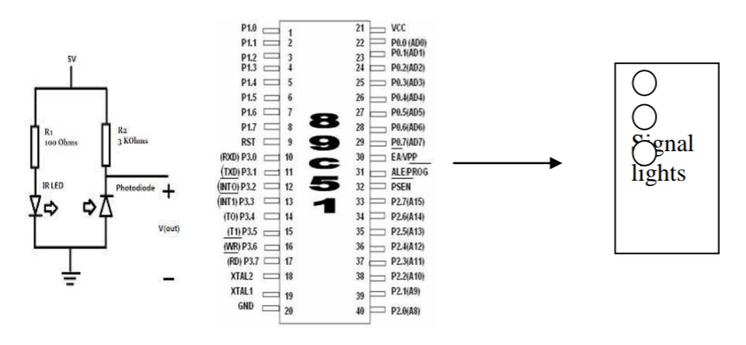
The same system can be used for creating green corridor to the emergency vehicle.
Here, the signal transmitted by the emergency vehicle is send to a photodiode. The output of the photodiode is applied to the microcontroller which drives the signal lights for fixed time duration. When signal transmitted by the emergency
vehicle overrides this signal, the signal turns green and remains green till the vehicle is passed. Once the vehicle is passed the microcontroller again switches to its normal mode of operation. Thus as the emergency vehicle passes ahead, it will make the signal green creating Green Corridor for it

Slide 20
Application Areas Of LiFi
Other
Application
Areas Of
LiFi Technology
Aviation
Underwater Communication
Hospitals
More Internet Connectivity

Slide 21
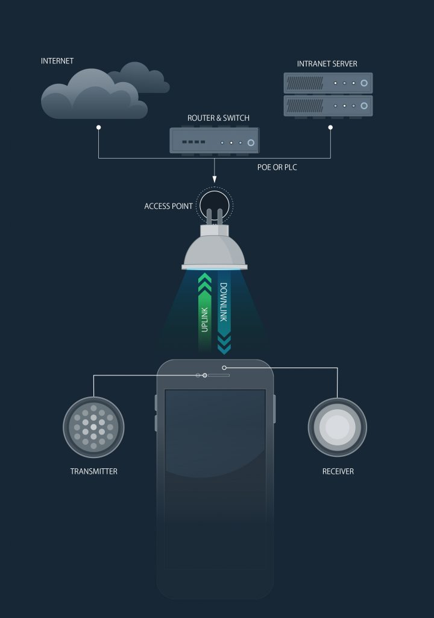
Challenging problems
Connectivity while moving
Multiuser support
Dimming
Shadowing

Slide 22
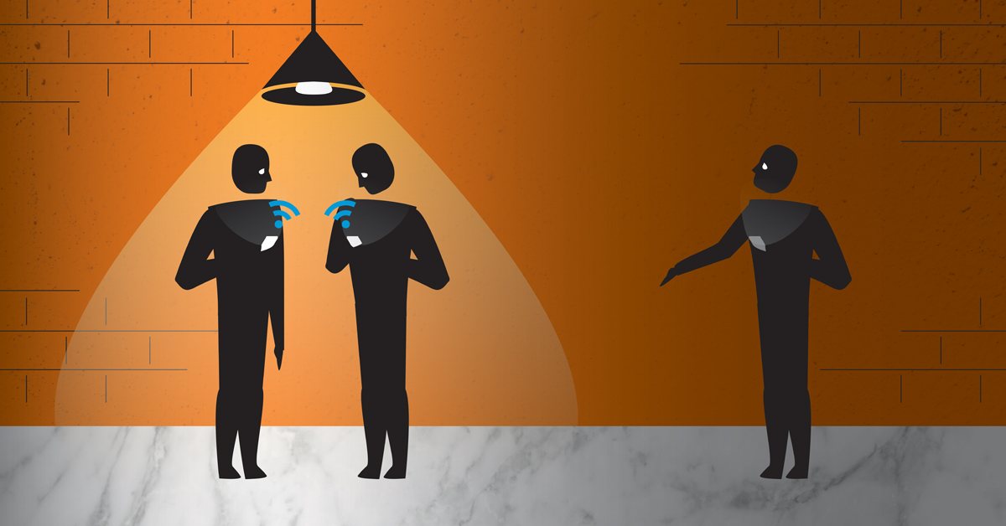
Solutions to Challenging problems
Solution for connectivity
This problem is similar to the connectivity problem in cellular network when you
move from one area of the city to another area while speaking with cell-phone. The
solution is called “handover”.
By this method the user is transferred from one BS to another Handover is done in the area that two BS’s have common coverage.
2. Solution for multiuser support
There are two types of solutions for multiuser support issue
time division multiplexing
code division multiple access
Time division multiplexing
Each frame is divided into equal time slots.
Each user transmits data in one time slot in a predefined order.
Code division multiple access
Codes are assigned to users.
Each user transmits its data using the assigned signature pattern.
It is used in 3G and 4G cellular networks

Slide 23
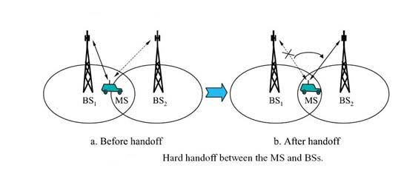
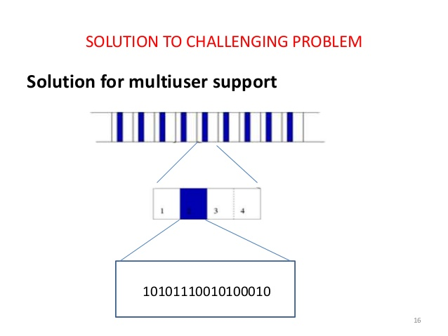
Data stream divided into frames
Frames divided into time slots . Each user is allocated one slot
Time slots contains data with a guard period if needed for synchronization

Slide 24
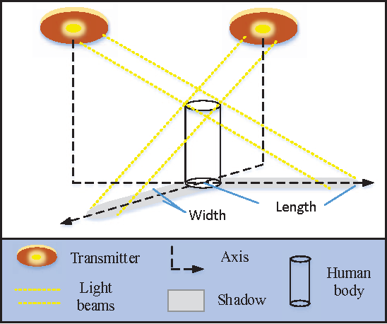
Solutions to Challenging problems
3. Solution for shadowing
When the line-of-sight (LOS) part (which is received via direct path) is blocked, the impulse response is only the second part.
Then the data can be recovered using the second part which is indeed the received data from the indirect paths (multipath signal)

Slide 25
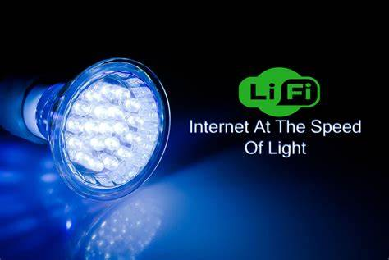
CONCLUSION
The possibilities are numerous and can be explored further. If his technology can be put into practical use,
every bulb can be used something like a Wi-Fi hotspot to transmit wireless data and we will proceed toward
the cleaner, greener, safer and brighter future. The concept of Li-Fi is currently attracting a great deal of
interest, not least because it may offer a genuine and very efficient alternative to radio-based wireless. As a
growing number of people and their many devices access wireless internet, the airwaves are becoming
increasingly clogged, making it more and more difficult to get a reliable, high-speed signal. This may solve
issues such as the shortage of radio-frequency bandwidth and also allow internet where traditional radio
based wireless isn’t allowed such as aircraft or hospitals. One of the shortcomings however is that it only
work in direct line of sight.

Slide 26
references
https://www.irjet.net/archives/V5/i2/IRJET-V5I260.pdf
https://lifi.co/what is LiFi%20is%20a%20wireless%20optical,radio%20waves%20to%20transmit%20information
https://lifi.co/what-is-lifi
LiFi tutorial-LiFi network,protocol,PHY,MAC,bands,modulation (rfwireless-world.com)
Li-Fi – Wikipedia
www.rfwireless-world.com
electronicslovers.com

